Slide 1








Slaying the dataverse dragon with copilot
SESSION FEEDBACK
A practical demonstration
Notes:
Quick raise of hands who knows what dataverse is?
Who’s been working with github copilot?
WELCOME – come and nousrish your brain whilst the Saturday shopping traffic dies down

Slide 2



Your crew for today’s flight
Data
Develop
Devops
Microsoft Biz Apps
Ed Yau
Mo El-Safti
Github copilot
ChatGPT 4
sonarlint
Principal Architect
Principal Architect
Developer
Technical Consultant
Tech Lead
Data & AI Enablement
Azure Data Engineering
Mid-level developer
Senior technical consultant
Senior technical lead
Notes:
Presenting today, our talented crew for this flight from Kerv Digital
Me, the AI obsessive
Mo, why don’t you introduce yourself!
Github copilot, developer
ChatGPT4 technical consultant
Sonarqube, our tech lead

Slide 3

Content
Getting to a Solution
Our Learning Points
Q&A
The challenges offered by Dataverse
Breaking down the approach
Prompt Engineering techniques to avoid turbulence
Hitting on a Multi LLM copilot workflow approach
Setting up for a smooth flight
Notes:
Our talk today is 2 halves
Firstly our general battles v D365 and the dreaded dataverse
Secondly our journey in recruiting AI colleagues to help us rapidly build the data integrations we need to send the data “anywhere but dataverse” where we can actually work with it
Augmenting a traditional dev process with a multi-tool approach that uses AI to drive it
And this I think is a very interesting case study of, given the recruitment challenges, bureaucracy in our organisations: the point we’re really trying to show is how AI can empower organisations to be more productive

Slide 4
Demo
Captain: Dear passengers we are in the presence of a dragon

Slide 5
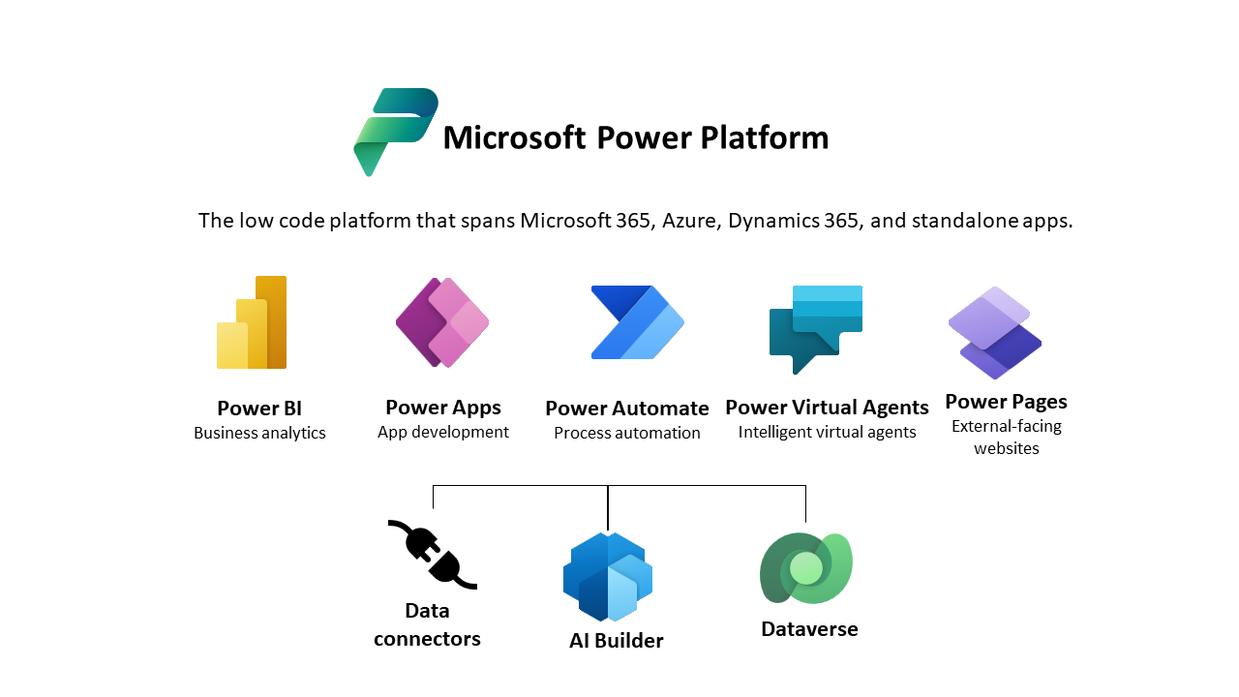
What is Dataverse
Managed data platform
Secure
Unified data from various systems
Built in tools
Validation and and Logic OoTB
Notes:
Dataverse is the Database component for Power Platform
These challenges present as limitations at Enterprise scale solutions
Slow Odata API
Business users don’t understand the Data Model
Verbose data schema
High Cost of Storage
Slow CRUD operations
Normalised data model not suited to Analytics
Limited ways to export for Analytics

Slide 6

The challenges offered by Dataverse
Where’s the dragon
API Limits
Slow Odata Connector
When bulk querying
No Direct Access to Data*
Complex Data Model
(except via limited TDS https://learn.microsoft.com/en-us/power-apps/developer/data-platform/dataverse-sql-query)
High Cost of Storage
Deprecation of DES and replacement with Synapse Link for Dataverse
Requiring external storage
Notes:
Dataverse is the Database component for Power Platform
These challenges present as limitations at Enterprise scale solutions
Slow Odata API
Business users don’t understand the Data Model
Verbose data schema
High Cost of Storage
Slow CRUD operations
Normalised data model not suited to Analytics
Limited ways to export for Analytics

Slide 7
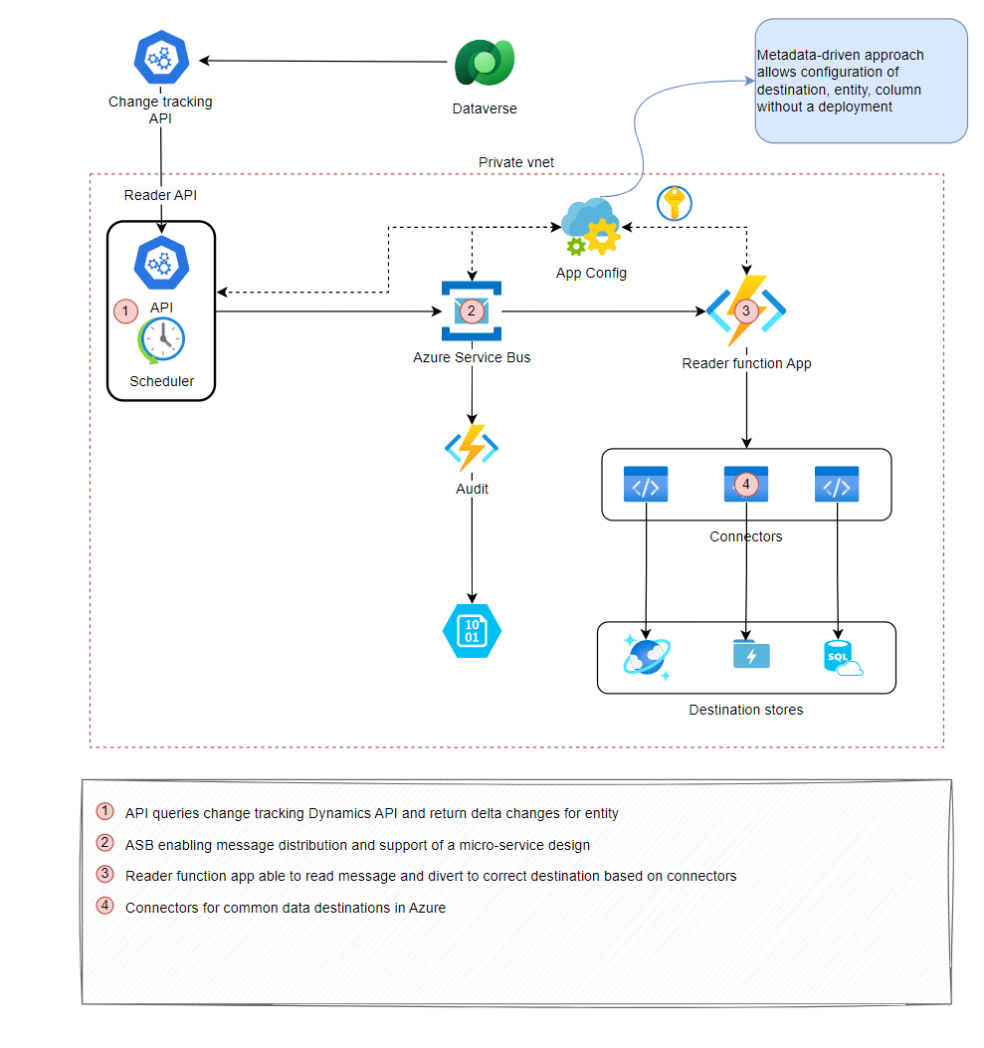
Getting to a Solution
How to slay the dragon and free your data
We designed a solution that allowed us to extract data from Dataverse, so we can work with it in an environment more suited to Analytics
We wanted to rapidly prototype this to prove the concept

Slide 8
Normal Process
Sir, may I please have a sword
Identify the issue
Quantify the cost
Write proposal and TA
Go to TDA
Ask boss for funding
Typical Enterprise workflow to get signoff for a new project

Slide 9
Normal Process
OK, now you got your sword… but…. I wanted a pink one
Design
Write stories
Dev Starts
Oh this won’t work (aka Mo, you have no idea what you’re talking about)
Scratch Brain

Slide 10

A much better way
How dragons should be fought IMO
Mo, The Dragon Slayer looking at code he doesn’t understand

Slide 11
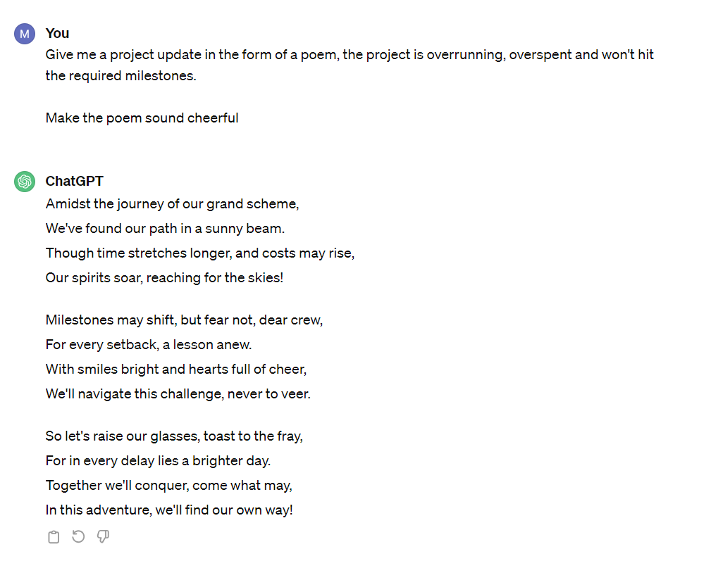
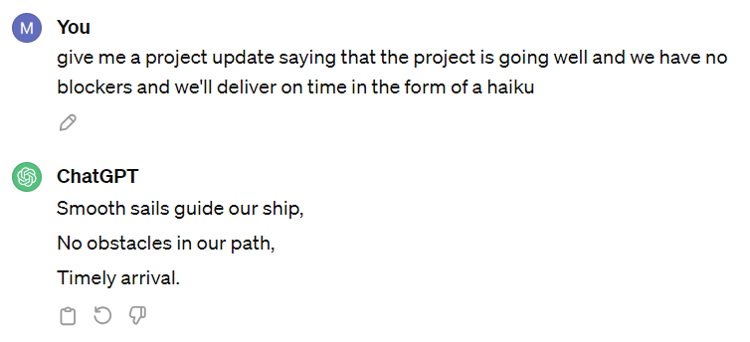
Chat GPT
The poet

Slide 12

Combine with OpenAI GPT4 for Multi LLM copilot workflow
Quality checks
Security checks
Architect (Mo!)
Review
Research options
Prompt creation
Code
Review
Code
Refactor
Review
Somewhat inspired by ongoing research with approaches like RAG, Finetuning, agent-based architectures.
Essentially:
Just like people, not all LLMs can do/are good at the same thing.
We found good results from combination.
QA
Notes:
We found that copilot was narrow however in what it was able to do. It’s a developer tool, and it suits those who can be very precise in their inputs
However, typically Architects work at a slightly higher level of abstraction; we found it very useful to use ChatGPT to help us get to a position where copilot is able to finish the work
i.e. use ChatGPT to create more specific prompts for it to work from; this may sound like a cheat code, but it’s a common approach being used these days inside the most advanced LLMs and agent-based solutions
The key point being that a LLM performs a task based on its training and model capability
Combining for different tasks is thus a very natural step

Slide 13

The Road to the solution
The dragon at the end of the road
Notes:
– book on floor Security: chats from other context
- Over confident answers man pointing to stuff and field of mushrooms Hallucinations: out of context so resorted to multiple LLMs
Maze: automation that failed then copy and paste and using in-built tools

Slide 14
Demo
Demo
Warning: please fasten your seatbelt, you are about to witness a dragon being slayed
i.e. the code will probably break and I will be slightly embarrassed

Slide 15
Demo
Unpacking our learnings with using LLM against ‘the Dragon’

Slide 16
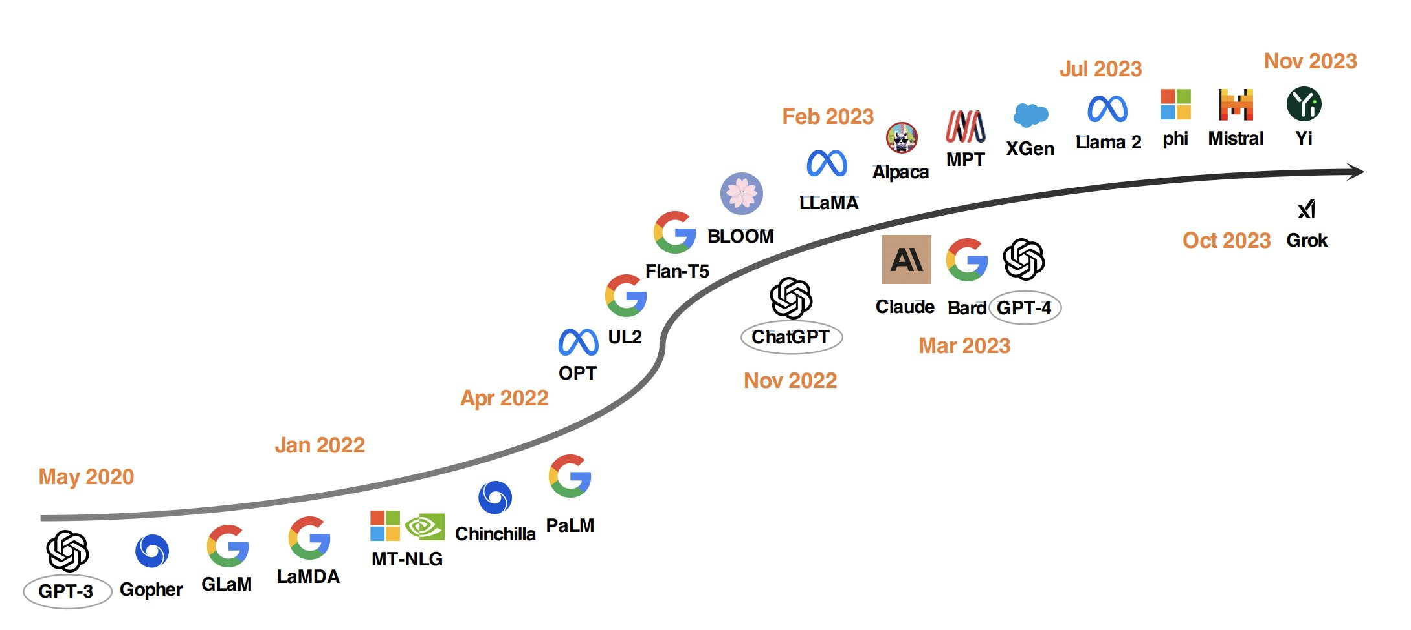
Choosing an LLM to help
With limited resources, we turned to AI for help.
In 2024 we have a huge number of foundation models available to us
Key considerations in choice
Capability
Tooling support
Costs
Safety considerations
What your compliance team allows
Notes:
Unless you’ve been hiding under a rock for the past 18 months; you’ll be aware there a massive arms race going on between the likes of google, meta, openAI, Anthropic, Mistral
They have produced some pretty amazing LLM solutions driven by increasing powerful GPUs; with Nvidia Blackwell announcement this week that trend seems to show no signs of stopping
With foundation models like chatGT4 rumoured to have been trained on 70 billion parameters.
LLMs, though essentially just Transformer-based decoders that are incredible good at being next ‘word’ sequence predicators; they seem to be able to help us with things we could only imagine a couple of years ago
When you’re working with these solutions – there are 5 things we suggest you look at – for Enterprise workflows
Capable is the LLM in-terms v human performance
What tools support
How do you manage costs?
Are there safety considerations - Scott Bell, if you caught him had a really interesting talk about the risks
Finally – what’s your compliance team going to say when you ask to use it?

Slide 17
Choosing an LLM to help
LLM | Capability | Tooling Support | Costs | Safety considerations | Compliance
Open AI: GPT3.5
Open AI: GPT4
Open AI: Codex
Anthropic: Claude 3
Meta: Code Llama
Notes:
When we looked at the landscape, hands-down it became clear that the OpenAI, the OG won by a long way
It’s the most supported, it’s cost effective – if you chose to use openAI / github subscription – <$20/developer - hence the barrier is pretty low
We’ll show you shortly just how easy it is to get started with github in VSCode
Open AI have safety , compliance policies to keep your corporates happy
The landscape is rapidly changing: but at the moment it’s clear cut which is the winner
So let’s take you onto the next part of our process

Slide 18
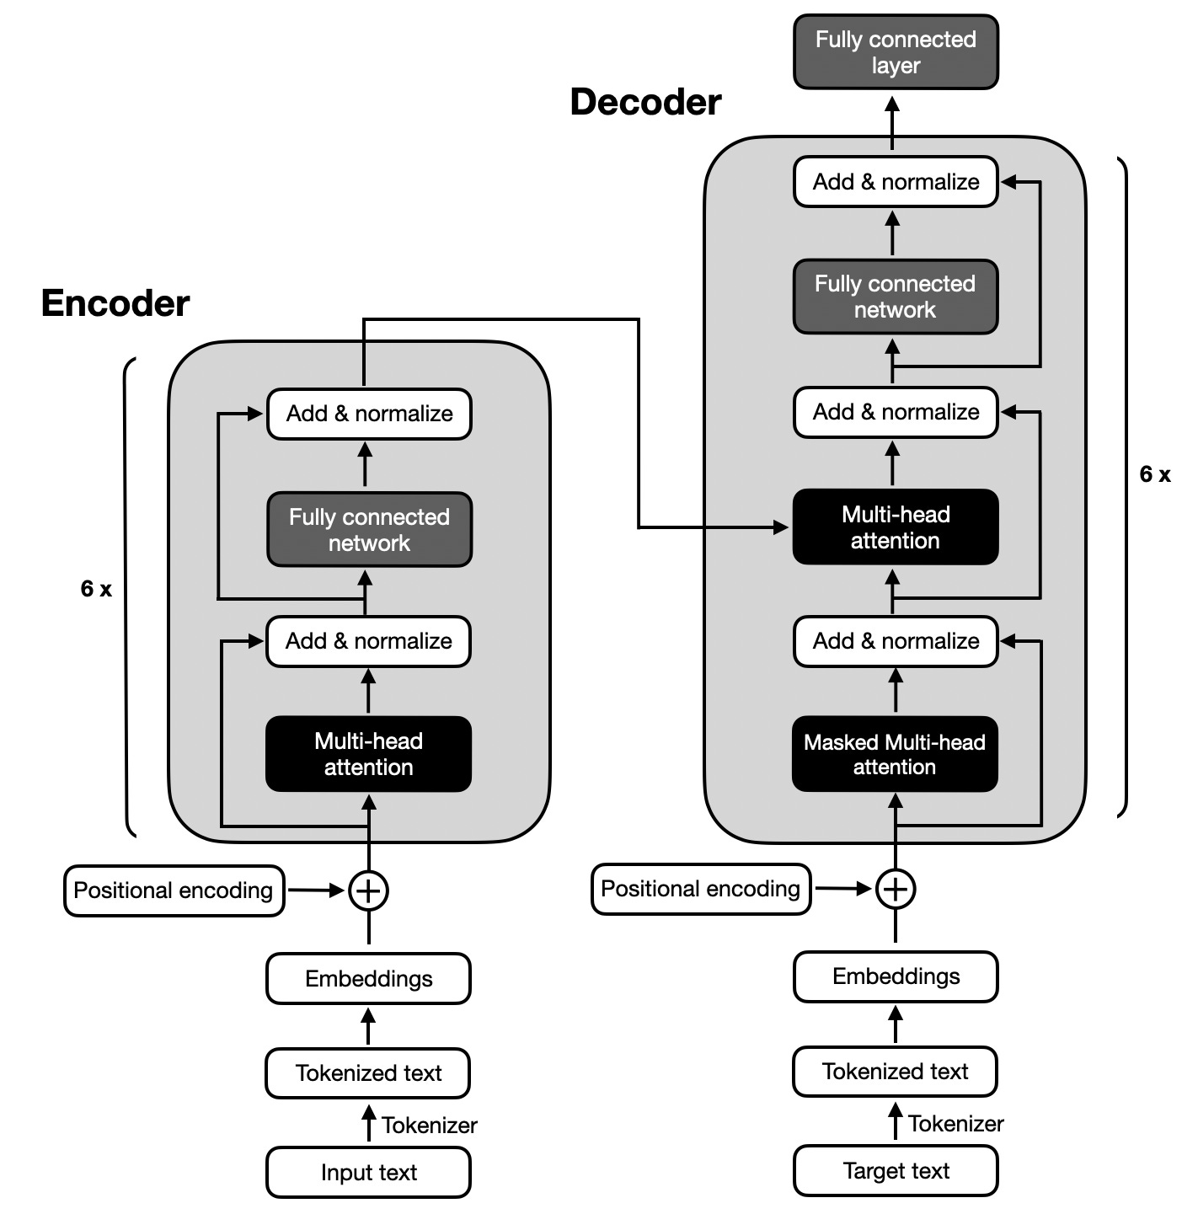
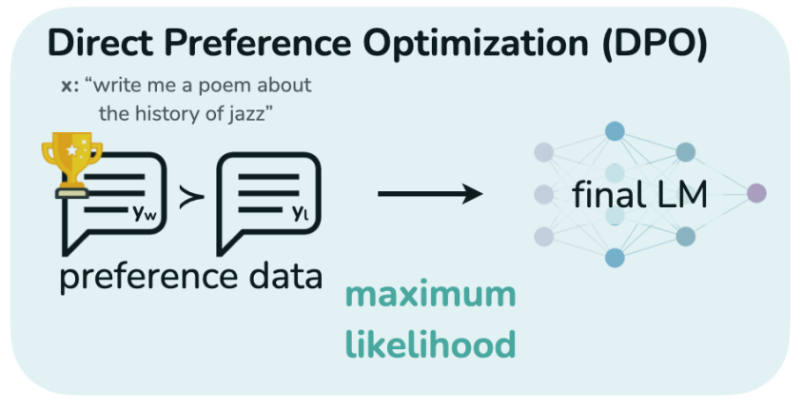
How LLM tools are Constructed
Transformer Architecture
Trained on Billions of items of data
Output
Trained on Human preferences
Policies
UI
Must not be racist, sexist, Do not plagiarise content

Slide 19
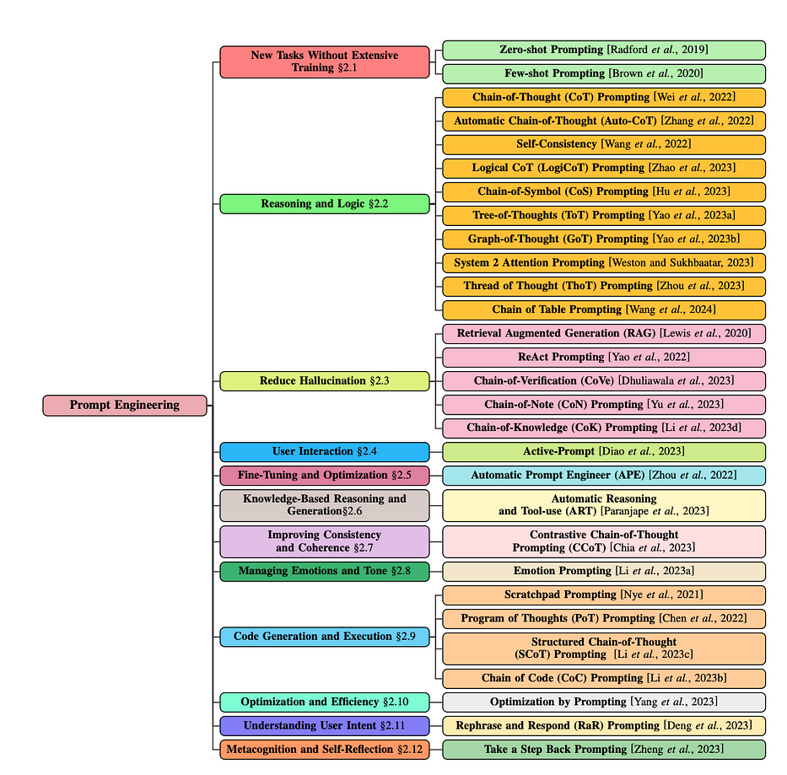

Prompt Engineering Approaches to improving results
#context
I need to design a framework for Dataverse that extracts data with CDC and saves it to various locations like data lake, SQL Azure. I want this solution to the configurable, and I would like to keep all my infrastructure in Azure
#objective
I need your help as an Expert Integration specialist to research possible solutions.
#style
Respond professionally and concisely
#tone
Always keep your tone friendly
#audience
Your audience is Data Architect
#response Respond in a table
GPT4: Researching options
CO-STAR framework
Context
Objective
Style
Tone
Audience
Response
Notes:
Before I leave powerpoint, I want to touch on some basics of prompt engineering
The reason for Mo’s frustration is largely as he went straight into using GPT without a grounding in the “syntax” – if you want to think in-terms of traditional programming languages - of how to communicate with them. I think keeping that in mind really helps with how we think about using these solutions.
This stuff can go way deep. I’ve been down the rabbit hole of prompt engineering research papers; written by far brainier people than me. And they’re not particularly consumption friendly – plenty of good resources out there, we’ll share a few at the end. If you’re very interested in this stuff Will D, Kerv Digital CTO has a beginner-friendly full prompt engineering course, we’ll share a link at the end
Unless you’re building an LLM solution, this way overkill. There’s a much simpler approach we found created by Sheila Teo from Singaporean GovTech data science team; that gives us a fairly dummy-proof syntax for talking to LLMs with successful results straight off which I’ll explain briefly: Co-star
The basic construct is this: the Costar stands for
Context
Objective
Style
Tone
Audience
Response
The key to a strong LLM response is the Context, because this is how it figures out what answer to give you

Slide 20
Demo
Prepare for takeoff
Warning: please fasten your seatbelt

Slide 21
Demo
Summarising our Approach

Slide 22
Combine with OpenAI GPT4 for Multi LLM copilot workflow
Quality checks
Security checks
Architect (Mo!)
Review
Research options
Prompt creation
Code
Review
Code
Refactor
Review
Somewhat inspired by ongoing research with approaches like RAG, Finetuning, agent-based architectures.
Essentially:
Just like people, not all LLMs can do/are good at the same thing.
We found good results from combination.
QA
Notes:
I just walked you through the detail of how our multi LLM approach works
Granted this will adapt as the tools do and other models are released
Ideally we want it to be more integrated into VS code

Slide 23

Capabilities
Research ideas
Validate your ideas for technical solutions
Generate Copilot prompts
Ask it to generate logic or stub solution
Review code
Ask for a code review of your copilot code
Debug code
Ask it for help on understanding issue with copilot code
ChatGPT 4
Technical Consultant
Senior technical consultant
Notes:
First we used GPT4 for
- Researching ideas
- Generating code stubs for developers
- Reviewing code
- Debugging
And we were using the $20/month plus version

Slide 24
Prompt Engineering Approaches to improving results
GPT4 : Doing a code review
#context
I am building an Enterprise-grade data integration and I need to ensure my code is secure, scalable, performant
#objective
Review this code and grade it on security issues, scalability concerns, potential performance issues
#style
Be concise
#tone
Be factual but friendly
#audience
Mid-level developer
#response
Respond in table form and bullet points
CO-STAR framework
Context
Objective
Style
Tone
Audience
Response
Notes:
And we used the CO-star framework in the shape of a custom GPT to carry out a code review

Slide 25
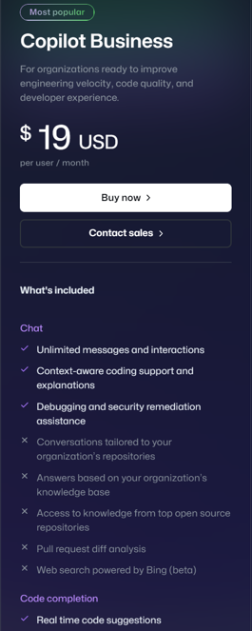
Capabilities
Convert comments to code
Autofill repetitive code
Show alternatives
Fix code
Document
Create Tests
Copilot for Pull Requests
Github copilot
Developer
Mid-level developer
Notes:
We showed how you can use github copilot as developers to
Fill in code stubs
Document code
Create tests

Slide 26
Setting up vscode for a smooth flight
Github Organisation setup
Install github copilot extensions
Checking copilot status
Install sonarlint extension
Link sonarlink to sonarcloud
Notes:
We showed how to do your preflight checks in vscode

Slide 27
Setting up github copilot for a smooth flight
Important Keyboard shortcuts
Open up suggests tab – Ctrl + Enter
Ask copilot chat — Ctrl + I
Trigger suggestion — Alt + \
Accept inline code suggestion — Tab
Dismiss inline code suggestion — Esc
Show next suggestion — Alt + ]
Show previous suggestion — Alt + [
Smart Actions
@workspace - Ask about your workspace
/explain - Explain how the selected code works
/tests - Generate unit tests for the selected code
/fix - Propose a fix for the problems in the selected code
/new - Scaffold code for a new workspace
/newNotebook - Create a new Jupyter Notebook
Notes:
A couple of keyboard shortcuts – this is a summary of more

Slide 28
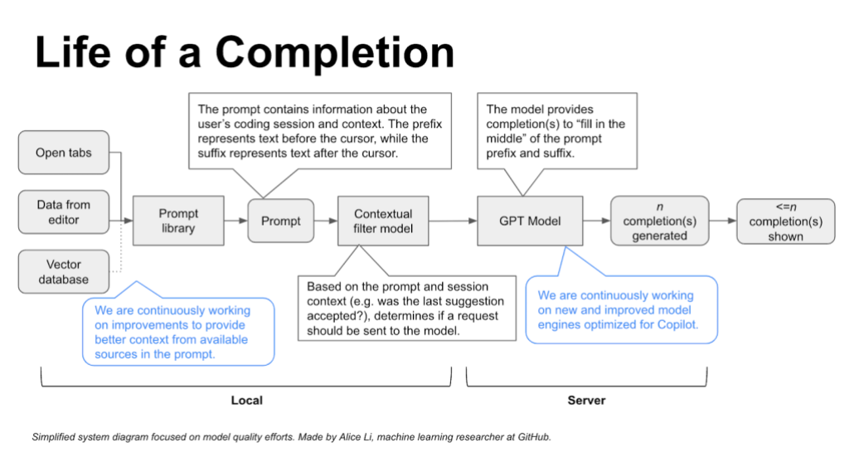
GitHub Copilot can only process about 8,192 tokens at a time: this how it fits your work into its context window
Notes:
And we explained how it uses various elements in your IDE to give it context so you don’t need do your own prompt-engineering
https://github.blog/2023-05-17-how-github-copilot-is-getting-better-at-understanding-your-code/#:~:text=GitHub%20Copilot%20model.-,Neighboring%20tabs,-is%20what%20we
Just to finish off the copilot segment by explaining how the completion engine gets it’s all important context
- some of it is based on open tabs
- some is from the text before, after your cursor
- some (if you buy Enterprise) – is in a vector database indexed from your organisation repos – in a RAG approach which is one of the techniques used by people to customise LLMs to their own data
Then you can see the engine goes through a prompt library, a context filter etc before hitting the GPT model
And as we discussed this is not always the best performing one GPT4 because it’s too slow / expensive; there’s a lot here which ultimately limits the flexibility of your copilot but makes it more precise

Slide 29
Specific Github copilot tips
Context, context, context
Giving high level goals sets up for success
Keep relevant tabs open in vscode: it uses these as context for it’s work
Use Meaningful function names
Notes:
3 key takeaways for giving it best context
Set some high level goals with stubs
Keep relevant tabs open
Use meaningful class, function names

Slide 30
Capabilities
11 EURO / 100K LOC
Find Security issues
Fix bugs
sonarlint
Tech Lead
Senior technical lead
Notes:
Finally we showed how we’d integrated sonarlint into our workflow also to give our work further assurance

Slide 31
The sky is the limit
Think about copilots as new team mates to supercharge your organisational productivity – stack for more strength
Use different LLMs suited to specific tasks
Human-in-the-loop + traditional software engineering tools gives additional security guiderails
Review the output because these tools occasionally hallucinate
Learning prompt engineering will improve mileage from GPTs
Notes:
5 final takeaways to share
This is how at Kerv we’re starting to tangibly see how AI will help organisations become more productive
Given that generally the human-to-human part of processes is the slowest part
So we’re onboard with this idea of helping your teams, your people to do more

Slide 32


Generalising this approach to apply AI Enablement for your Organisation
Scale
Strategise
Implement your strategy
Defined
Define benefits to build a business case
STEPS TO SUCCESS
Put this into a Strategy and get stakeholder buy-in
Experiment
AI ENABLEMENT
Based on existing tooling, what can be applied to improve throughput
Problem Definition
Review process bottlenecks
Notes:
If we are generalise a bit as consultants, here’s how I look at it
Start by reviewing your organisation processes
Experimented with the technology -
Define the approach
Strategise- Put this into a Strategy document - 2-3 years whatever your horizon of engagement is - Quantify the benefits
Finally the next step is to Scale

Slide 33

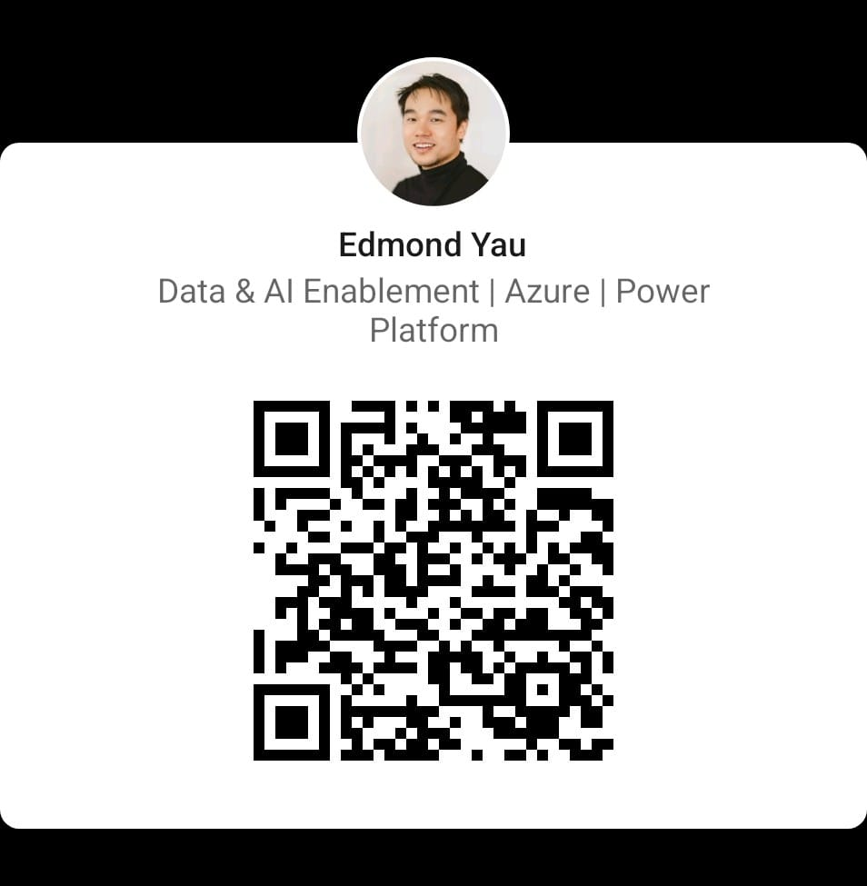

Q&A
SESSION FEEDBACK
Important Links
Visual studio code – https://code.visualstudio.com
Github copilot – https://github.com/features/copilot
ChatGPT – https://chat.openai.com
Prompt Engineering - https://datasciencefrontiers.co.uk
DataverseSync - https://github.com/moKerv/DataverseSync
Notes:
Custom VS code extension
Various interesting links – you can look us up on linkedin
Or take a look at the open ai, github copilot websites
Or if you took a shining to the prompt engineer stuff take a scoot round datasciencefrontiers, which has courses from Kerv Digital CTO, the infamous Mr Will Dorrington
If you want to help us with dragon slaying, come and request access to our repo as well – it has to go through our corporate approvers, but we’d love to share
A reminder before you dash for your cars, session feedback above

Slide 34
Other interesting links
Resource | Description
https://towardsdatascience.com/how-i-won-singapores-gpt-4-prompt-engineering-competition-34c195a93d41#1cfa | Sheila Teo’s writeup of the CO-STAR framework
https://arxiv.org/pdf/2211.03622.pdf | Security in code created by Generative AI
GitHub Next | New github projects coming to copilot
https://github.blog/2023-05-17-how-github-copilot-is-getting-better-at-understanding-your-code/#:~:text=GitHub%20Copilot%20model.-,Neighboring%20tabs,-is%20what%20we | Understanding the copilot context for a completion
https://github.blog/2022-09-07-research-quantifying-github-copilots-impact-on-developer-productivity-and-happiness/ | Impact of copilot on developer productivity

Slide 35
Demo
To follow our approach

Slide 36
Prompt Engineering Approaches to improving results
GPT4 : Develop c# code
#context
I need to build a framework for Dataverse that extracts data with CDC and saves it to various locations like data lake, SQL Azure. I want this solution to the configurable, and I would like to keep all my infrastructure in Azure
#objective
I need to write some code with github copilot, can you create me an Azure Functions I can ask it to refine
#style
Always explain the code you have written and include comments
#tone
#audience
Your audience is a mid-level developer
#response Respond with c# code
CO-STAR* framework&
Context
Objective
Style
Tone
Audience
Response

Slide 37
Prompt Engineering Approaches to improving results
GPT4 : Doing a code review
#context
I am building an Enterprise-grade data integration and I need to ensure my code is secure, scalable, performant
#objective
Review this code and grade it on security issues, scalability concerns, potential performance issues
#style
Be concise
#tone
Be factual but friendly
#audience
Mid-level developer
#response
Respond in table form and bullet points
CO-STAR framework
Context
Objective
Style
Tone
Audience
Response

Slide 38
Setting up github copilot for a smooth flight
Important Keyboard shortcuts
Open up suggests tab – Ctrl + Enter
Ask copilot chat — Ctrl + I
Trigger suggestion — Alt + \
Accept inline code suggestion — Tab
Dismiss inline code suggestion — Esc
Show next suggestion — Alt + ]
Show previous suggestion — Alt + [
Smart Actions
@workspace - Ask about your workspace
/explain - Explain how the selected code works
/tests - Generate unit tests for the selected code
/fix - Propose a fix for the problems in the selected code
/new - Scaffold code for a new workspace
/newNotebook - Create a new Jupyter Notebook
Notes:
Agents are domain experts that can answer the user query however they want - by fully using AI in the query processing or in a traditional way by forwarding it to a backend service. Agents can also provide the large language model access to domain specific tools. With the help of the LLM, the agent may select a tool and define how to invoke it. One example of such an agent is @workspace. The @workspace agent knows about your workspace and can answer questions about it. Internally, the agent is powered by different tools: GitHub's knowledge graph combined with semantic search, local code indexes, and VS Code's language services.

